Slide 1
CS 461 - Computer Graphics
A few applications
Amal Dev Parakkat

Slide 2
Course Wrapup
Total 46+ hours (20h+22h+4h) + Project presentation
Topics: Rasterization, Drawing algorithms, Splines, Polygons, Filling algorithms, Viewing & Clipping, 2D, 3D & Camera Transformations, Surface representations, Introduction to digital geometry processing, Culling & HSE, Colors, Shading, Hierarchical Modeling, Shadows, Texture Mapping, Ray casting & Ray tracing, Introduction to animation
References: MIT 6.837 Computer Graphics, CMU 15-462/662 Computer Graphics, UCD ECS175 Computer Graphics, Graphics & Visualization by Theoharis et al., Computer Graphics by Hearn & Baker, ...

Slide 3
Course Wrapup
Followed a little bit different strategy
Assignments + Seminar + Project
Please send your feedback to my personal email ID - adp.upasana@gmail.com
All of you are welcome to join the project presentations
First presentation: Today 11 am - Topic: Interactive Continuous Collision Detection for Non-Convex Polyhedra - By: Sparsh Sinha, Shashank, and Rishi
Grades will be uploaded before 16th November - Marks (except the marks for course project) will be available by next weekend (sheets will be shared ASAP), let me know of any discrepancies (no later than 13th)

Slide 4
A few cool applications!!!

Slide 5
Sketches to animation

Slide 6
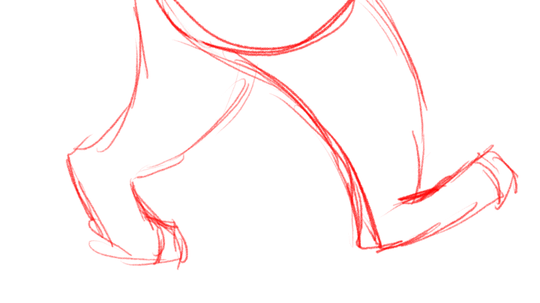
Cleaning rough raster sketches
© Maelene Naftzger

Slide 7
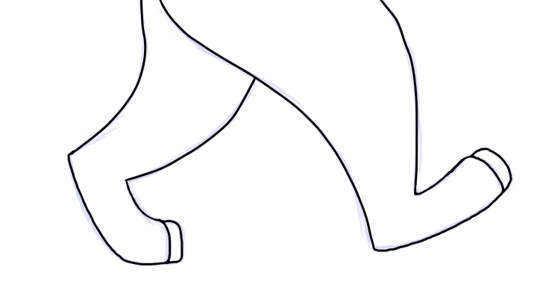
Cleaning rough raster sketches
© Maelene Naftzger

Slide 8
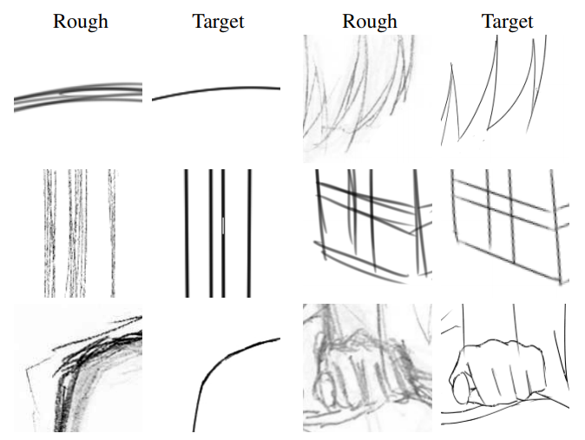
Cleaning rough raster sketches
© Edgar Simo-Serra et al.

Slide 9
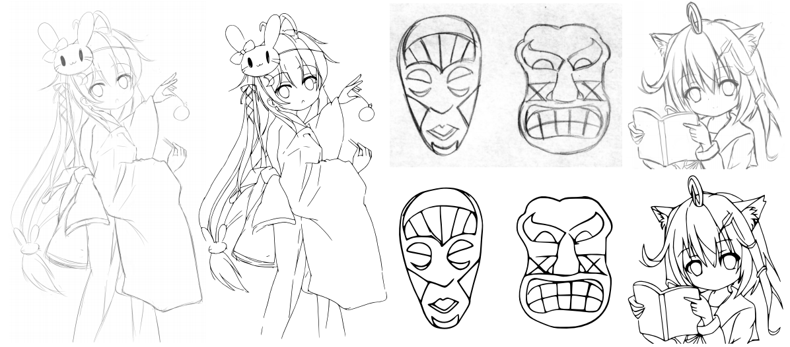
Cleaning rough raster sketches
© Edgar Simo-Serra et al.

Slide 10
Cleaning rough raster sketches
Edgar Simo-Serra et al., Learning to Simplify: Fully Convolutional Networks for Rough Sketch Cleanup, ACM Transactions on Graphics. 35, 4, 2016
Edgar Simo-Serra et al., Real-time data-driven interactive rough sketch inking, ACM Transactions on Graphics. 37, 4, 2018
Chuan Yan et al., A Benchmark for Rough Sketch Cleanup, ACM Transactions on Graphics., 39, 6, 2020

Slide 11

Sketch coloring
© Maelene Naftzger

Slide 12
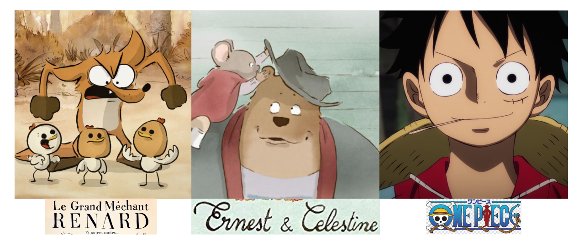
Sketch coloring

Slide 13

Sketch coloring
© PaintsChainer

Slide 14
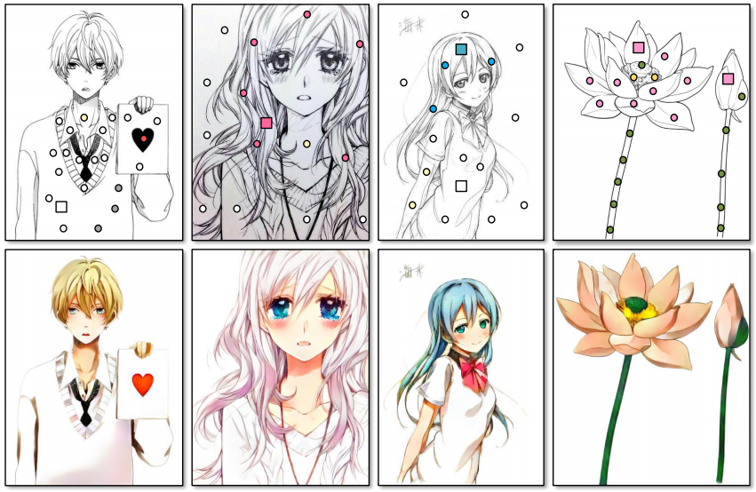
Sketch coloring
© Lvmin Zhang et al.

Slide 15
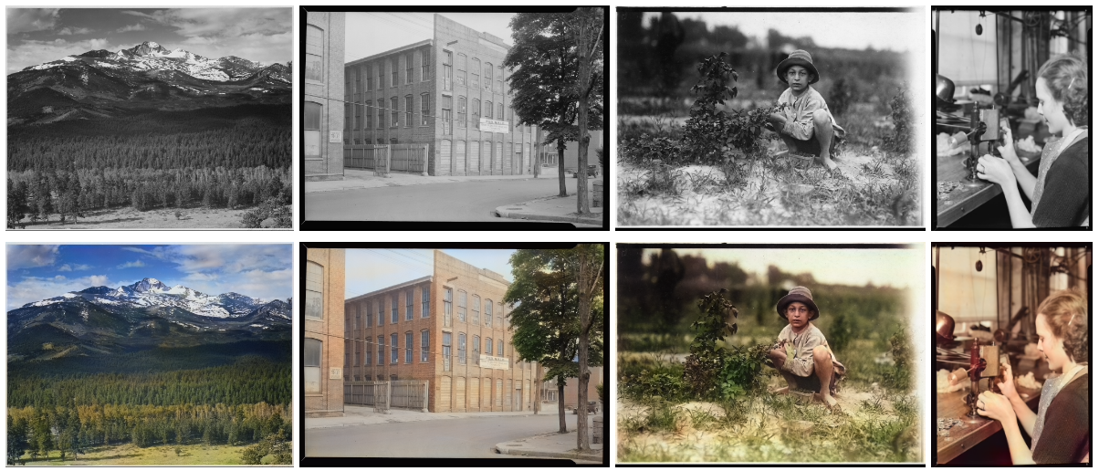
Sketch coloring
© Satoshi Lizuka et al.

Slide 16
Sketch coloring
Lvmin Zhang et al., Two-stage Sketch Colorization, ACM Transactions on Graphics. 37, 6, 2018
Satoshi Lizuka et al., Let there be Color!: Joint End-to-end Learning of Global and Local Image Priors for Automatic Image Colorization with Simultaneous Classification, ACM Transactions on Graphics. 35, 4, 2016

Slide 17
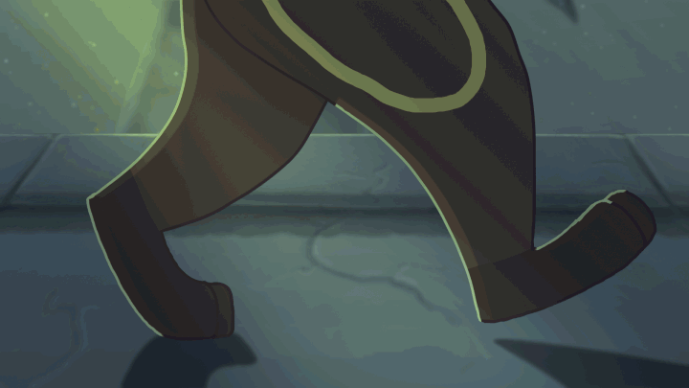
Shading
© Maelene Naftzger

Slide 18
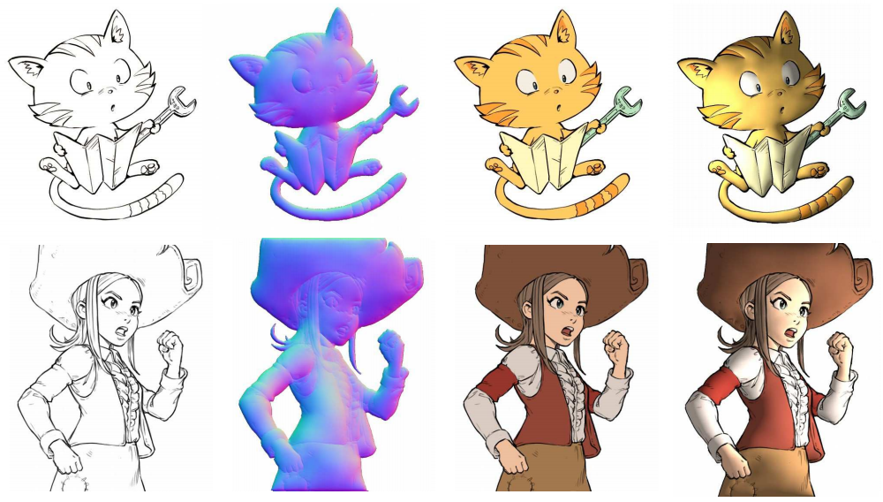
Shading
© Matis Hudon et al.

Slide 19
Shading
Matis Hudon et al., Deep Normal Estimation for Automatic Shading of Hand-Drawn Characters, ECCV 2018
Wanchao Su et al., Interactive Sketch-Based Normal Map Generation with Deep Neural Networks, Proc. ACM Comput. Graph. Interact. Tech., Vol. 1, No. 1, Article 22., 2018
Qingyuan Zheng et al., Learning to shadow Hand-drawn sketches, CVPR 2020

Slide 20
Is it only for sketches?

Slide 21

Image to 3D photography
© Meng-Li Shih et al.

Slide 22
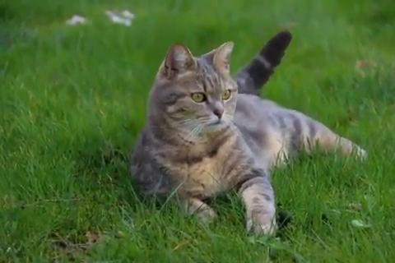
Image to 3D photography
© Meng-Li Shih et al.

Slide 23
Image to 3D photography
Meng-Li Shih et al., 3D Photography using Context-aware Layered Depth Inpainting, CVPR 2020
Inchang Choi et al., Extreme View Synthesis, ICCV 2019
Ben Mildenhall et al., Local Light Field Fusion: Practical View Synthesis with Prescriptive Sampling Guidelines, ACM Trans. Graph., Vol. 38, No. 4, 2019

Slide 24
Normal approximation is enough?

Slide 25
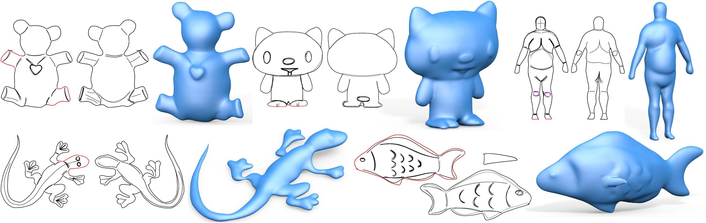
Sketch to 3D model
© Changjian Li et al.

Slide 26
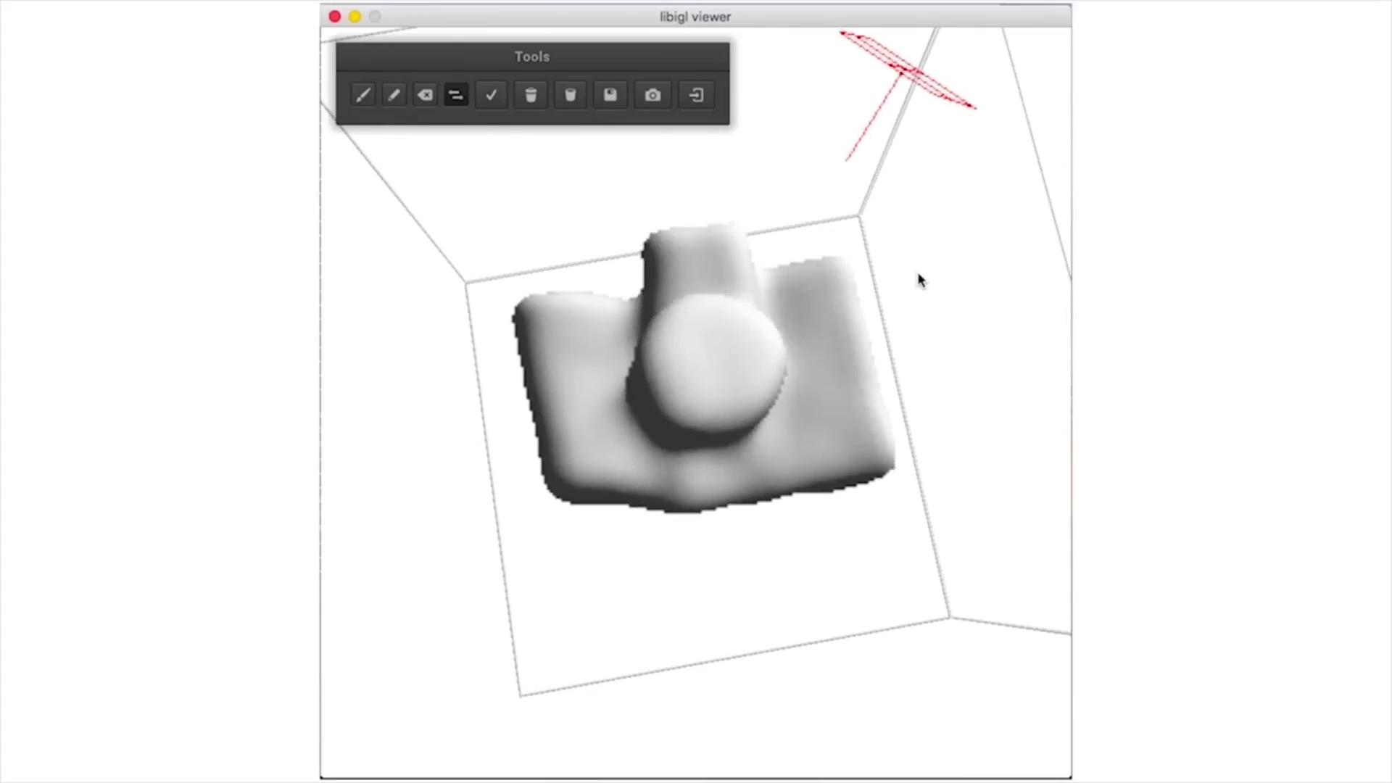
Sketch to 3D model
© Johanna Delanoy et al.

Slide 27
Sketch to 3D model
Changjian Li et al., Robust Flow-Guided Neural Prediction for Sketch-Based Freeform Surface Modeling, ACM Transactions on Graphics, Vol. 37, No. 6, 2018
Yuan yo et al., Front2Back: Single View 3D Shape Reconstruction via Front to Back Prediction, CVPR 2020
Johanna Delanoy et al., Combining Voxel and Normal Predictions for Multi-View 3D Sketching, Computers & Graphics 2019
Johanna Delanoy et al., 3D Sketching using Multi-View Deep Volumetric Prediction, Proceedings of the ACM on Computer Graphics and Interactive Techniques, 2018

Slide 28
What if we are lazy?

Slide 29
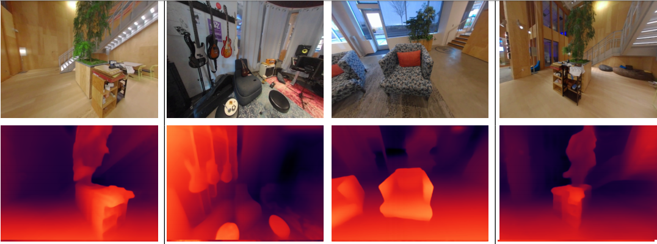
Depth estimation
© Xuan Luo et al.

Slide 30
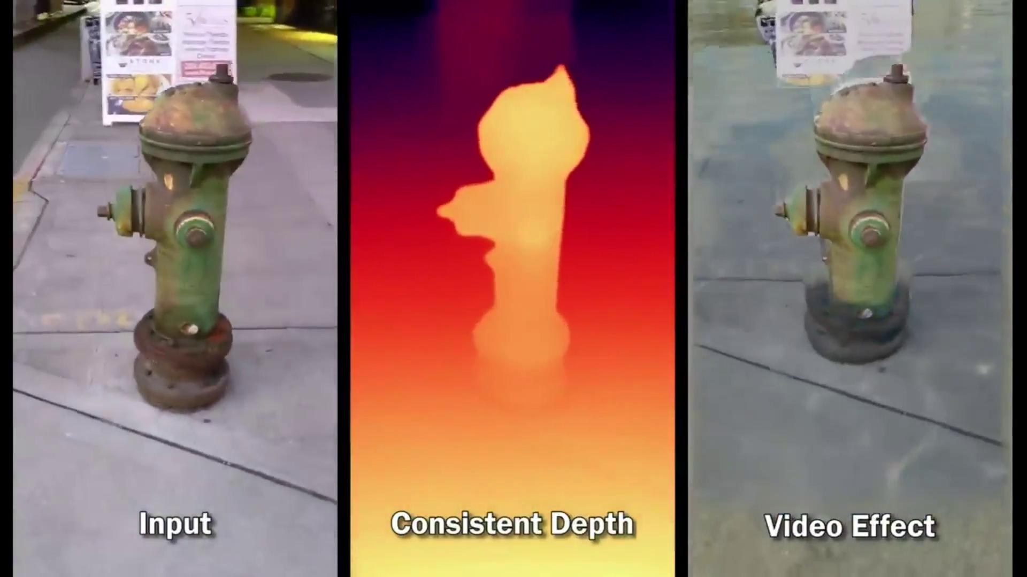
Depth estimation
© Xuan Luo et al.

Slide 31
Depth estimation
Xuan Luo et al., Consistent Video Depth Estimation, ACM Trans. Graph., Vol. 39, No. 4, 2020
Filippo Aleotti et al., Real-time single image depth perception in the wild with handheld devices, arXiv 2020
M. Pogi et al., Facing depth estimation in the wild with deep networks, ECCV 2020

Slide 32
What is objects are occluded?

Slide 33
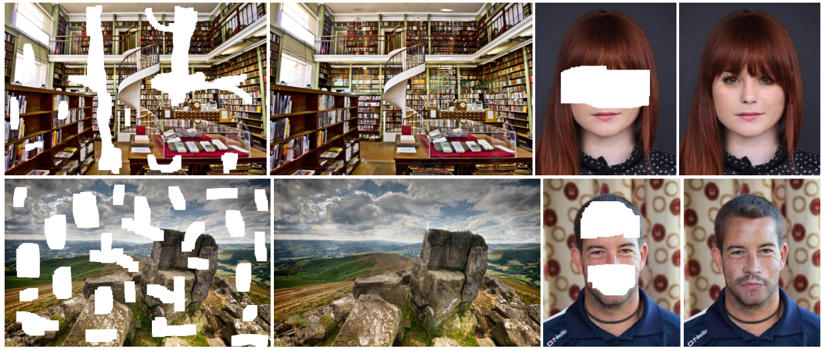
Image completion
© Satoshi Iizuka et al.

Slide 34
Image completion
Satoshi Iizuka et al., Globally and Locally Consistent Image Completion, ACM Transactions on Graphics, Vol. 36, No. 4, 2017
Deepak Pathak et al., Context Encoders: Feature Learning by Inpainting,CVPR 2016
Raymond A. Yeh et al., Semantic Image Inpainting with Deep Generative Models, CVPR 2016
Jiahui Yu et al., Generative Image Inpainting with Contextual Attention, CVPR 2018

Slide 35
Traditional images are boring :-(

Slide 36
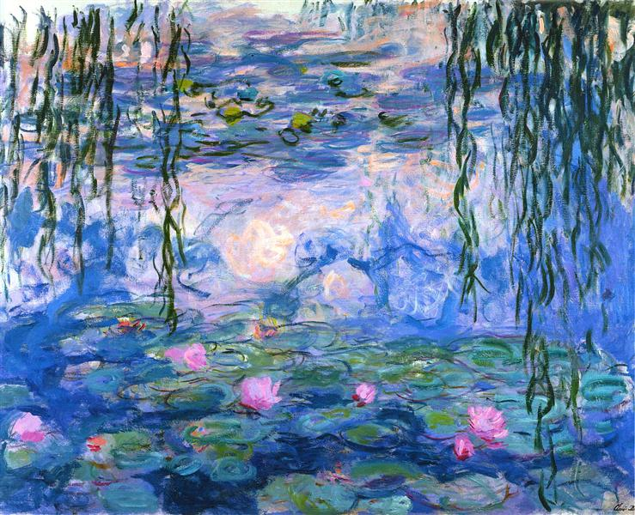
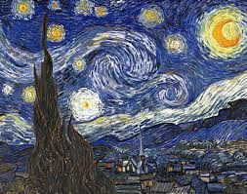
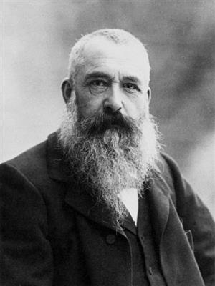
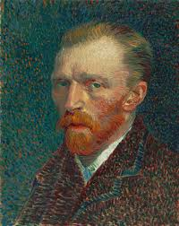
Photo stylization

Slide 37
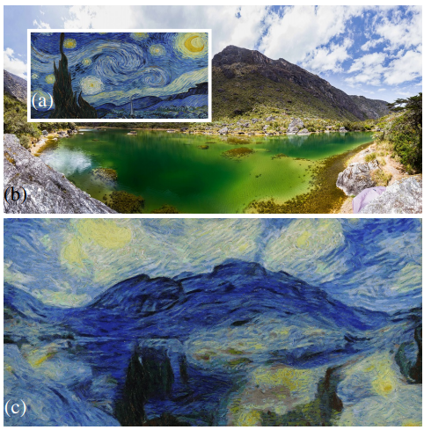
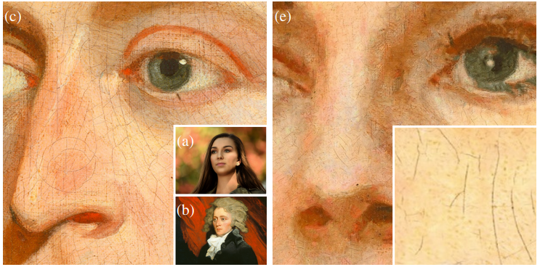
Photo stylization
© Ondrej Texler et al.

Slide 38
Photo stylization
Ondrej Texler et al., Arbitrary Style Transfer Using Neurally-Guided Patch-Based Synthesis, Computers & Graphics 2020
D. Futschik et al., Real-Time Patch-Based Stylization of Portraits Using Generative Adversarial Network, Expressive 2019
Jing Liao et al., Visual attribute transfer through deep image analogy, ACM Transactions on Graphics, Vol. 36, No. 4, 2017
Shuyang Gu et al., Arbitrary Style Transfer with Deep Feature Reshuffle, CVPR 2018

Slide 39
I am not interested in Images :-/

Slide 40
Video stylization
© Ondrej Texler et al.

Slide 41
Video stylization
Ondrej Texler et al., Interactive Video Stylization Using Few-Shot Patch-Based Training, ACM Transactions on Graphics, Vol. 39, No. 4, 2020
Ondrej Jamriska et al., Stylizing Video by Example, ACM Transactions on Graphics, Vol. 38, No. 4, 2019
David Futschik et al., Real-Time Patch-Based Stylization of Portraits Using Generative Adversarial Network, Expressive 2019

Slide 42
But all the faces are familiar

Slide 43


Faces!!!
© Ian Goodfellow et al.

Slide 44
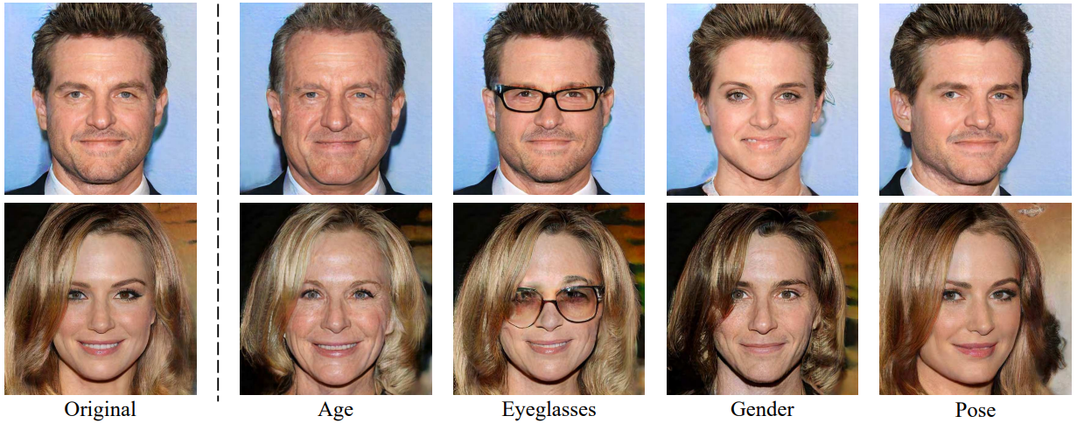
Faces!!!
© Yujun Shen et al.

Slide 45
Hmm, pretty cool!!! Can we do more?

Slide 46
Faces!!!
© Hyeongwoo Kim et al.

Slide 47

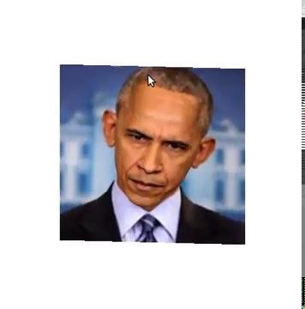
3D face reconstruction
© Aron Jackson et al.

Slide 48
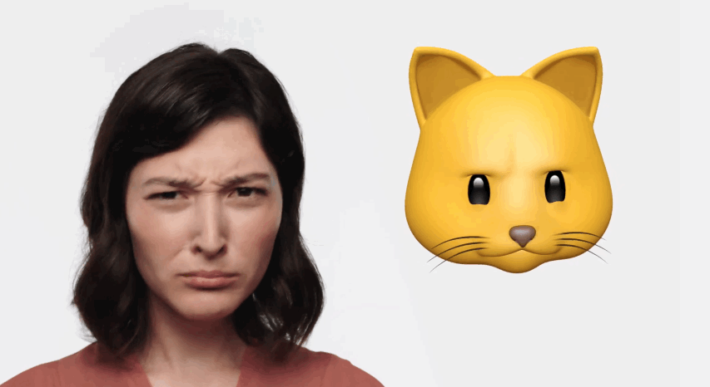
3D face reconstruction
© Apple Inc.

Slide 49
Animating portraits
© Hadar Averbuch-Elor et al.

Slide 50
Faces
Ian Goodfellow et al., Generative Adversarial Networks, Communications of the ACM 2020
Tim Salimans et al., Improved Techniques for Training GANs, International Conference on Neural Information Processing Systems, 2016
Yujun Shen et al., Interpreting the Latent Space of GANs for Semantic Face Editing, CVPR 2020
Hyeongwoo Kim et al., Deep Video Portraits, ACM Transactions on Graphics, Vol. 37, No. 4, 2018

Slide 51
3D face reconstruction
Aaron S. Jackson et al., Large Pose 3D Face Reconstruction from a Single Image via Direct Volumetric CNN Regression, ICCV 2017
Anh Tuan Tran et al., Extreme 3D Face Reconstruction: Seeing Through Occlusions, CVPR 2018
Xiaoguang Tu et al., 3D Face Reconstruction from A Single Image Assisted by 2D Face Images in the Wild, IEEE Transactions on Multimedia 2020
Anh Tuan Tran et al., Regressing Robust and Discriminative 3D Morphable Models with a very Deep Neural Network, CVPR 2017

Slide 52
3D face reconstruction
Bernhard Egger et al., 3D Morphable Face Models—Past, Present, and Future, ACM Transactions on Graphics, Vol. 39, No. 5, 2020
Hadar Averbuch-Elor et al., Bringing portraits to life, ACM Transactions on Graphics, Vol. 36, No. 6, 2017

Slide 53
Just face is enough? Are we missing something?

Slide 54
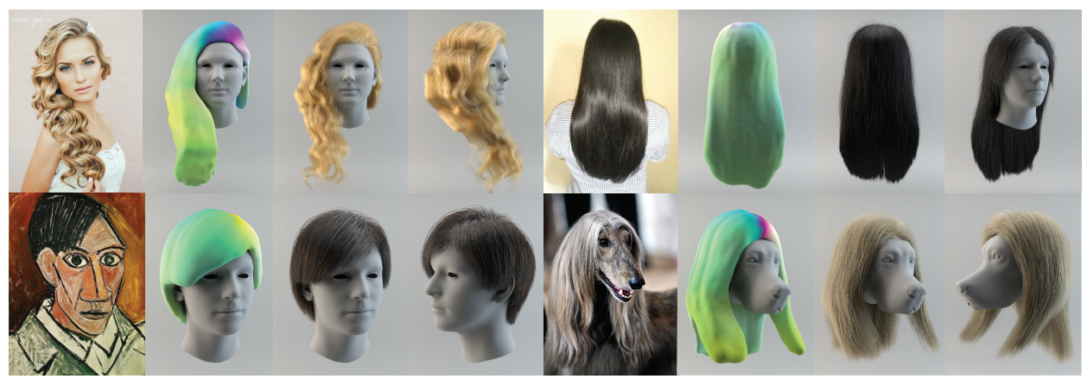
3D hair synthesis
© Shunsuke Saito et al.

Slide 55
3D hair synthesis
Shunsuke Saito et al., 3D Hair Synthesis Using Volumetric Variational Autoencoders, ACM Trans. Graph., Vol. 37, No. 6, 2018
Yuefan Shen et al., DeepSketchHair: Deep Sketch-based 3D Hair Modeling, IEEE Transactions on Visualization and Computer Graphics 2019
Meng Zhang et al., Hair-GANs: Recovering 3D Hair Structure from a Single Image, IEEE Transactions on Visualization and Computer Graphics 2018

Slide 56
Sometimes we need to edit the meshes!!!
Would have been easy if they are segmented

Slide 57
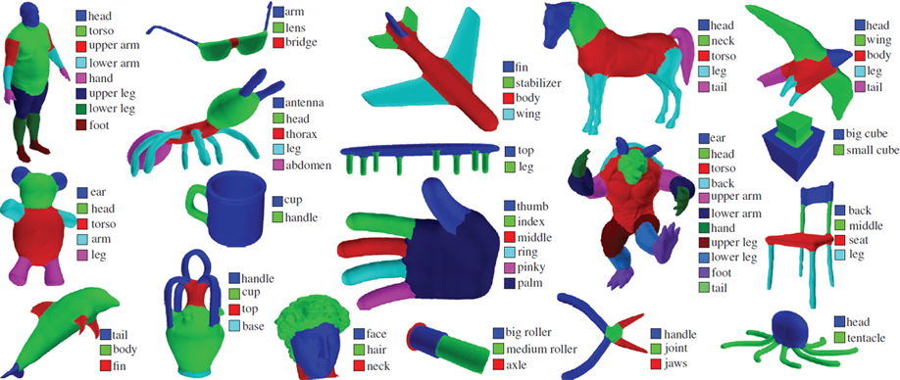
3D segmentation
© Evangelos Kalogerakis et al.

Slide 58
3D segmentation
Evangelos Kalogerakis et al., Learning 3D Mesh Segmentation and Labeling, ACM Transactions on Graphics, Vol. 29, No. 3, 2010
Evangelos Kalogerakis et al., 3D Shape Segmentation with Projective Convolutional Networks, CVPR 2017
Zhiqing Chen et al., BAE-NET: Branched Autoencoder for Shape Co-Segmentation, ICCV 2019
Pengyu Wang et al., 3D Shape Segmentation via Shape Fully Convolutional Networks, Computers & Graphics 2018

Slide 59
How to get these meshes?

Slide 60
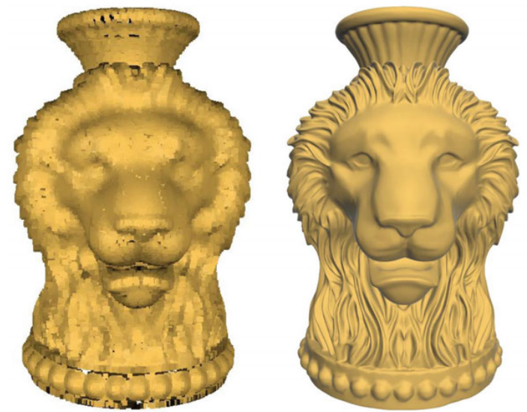
Surface reconstruction
© Shiyao Xiong et al.

Slide 61
Surface reconstruction
Shiyao Xiong et al., Robust surface reconstruction via dictionary learning, ACM Transactions on Graphics, Volume 33, Issue 6, 2014
Philipp Erler et al., Points2Surf: Learning Implicit Surfaces from Point Clouds, ECCV 2020
Francis Williams et al., Deep Geometric Prior for Surface Reconstruction, CVPR 2019
Meng Jia and Matthew Kyan, Learning Occupancy Function from Point Clouds for Surface Reconstruction, arXiv 2020

Slide 62
Is it that easy?

Slide 63
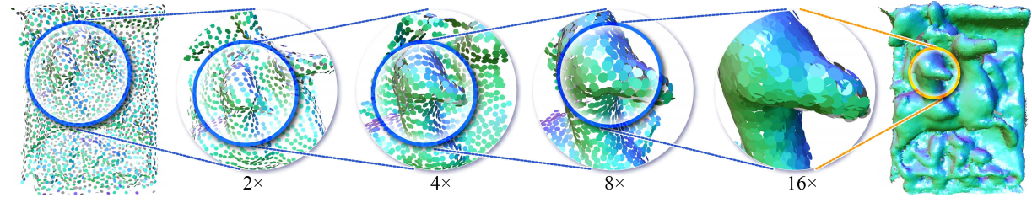
Point cloud upsampling
© Wang Yifan et al.

Slide 64
Point cloud upsampling
Wang Yifan et al., Patch-based Progressive 3D Point Set Upsampling, CVPR 2019
Lequan Yu et al., PU-Net: Point Cloud Upsampling Network, CVPR 2018
Wentai Zhang et al., Data-driven Upsampling of Point Clouds, Computer-Aided Design 2019
Ruihui Li et al., PU-GAN: a Point Cloud Upsampling Adversarial Network, ICCV 2019

Slide 65
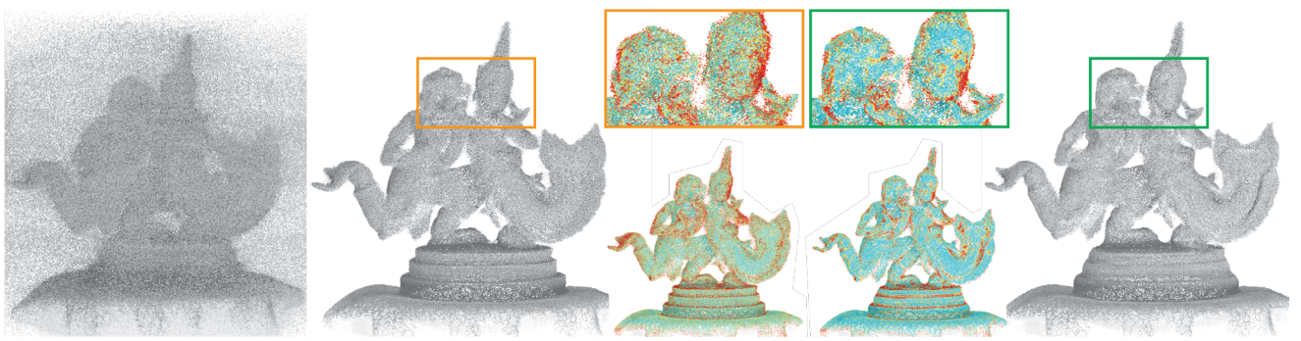
Point cloud de-noising
© Marie-Julie R. et al.

Slide 66
Point cloud de-noising
Marie-Julie Rakotosaona et al., PointCleanNet: Learning to Denoise and Remove Outliers from Dense Point Clouds, Computer Graphics Forum 2019
Pedro Hermosilla et al., Total Denoising: Unsupervised Learning of 3D Point Cloud Cleaning, ICCV 2019
Jean-Emmanuel Deschaud et al., Point Cloud Non Local Denoising using Local Surface Descriptor Similarity, IAPRS 2010

Slide 67
Can we make it look beautiful?

Slide 68
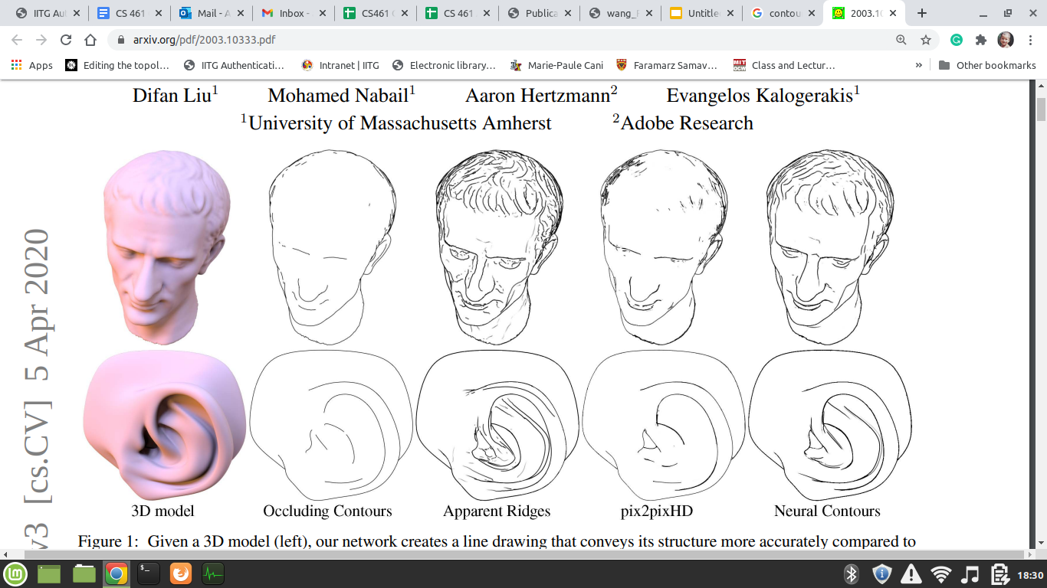
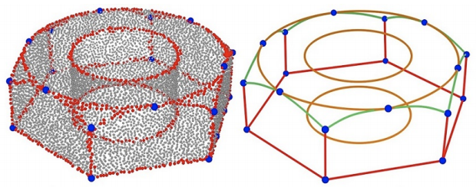
Contour line generation
©Xiaogang Wang et al.
© Difan Liu et al.

Slide 69
Contour line generation
Difan Liu et al., Neural Contours: Learning to Draw Lines from 3D Shapes, CVPR 2020
Bastien Wailly and Adrien Bousseau, Line rendering of 3D meshes for data-driven sketch-based modeling, Journées Françaises d’Informatique Graphique et de Réalité Virtuelle 2019
Forrester Cole et al., Where Do People Draw Lines?, ACM Transactions on Graphics, August 2008
F. de Goes et al., Exoskeleton: Curve Network Abstraction for 3D Shapes, Computers & Graphics 2011

Slide 70
Don’t worry, we can manipulate the mesh itself

Slide 71
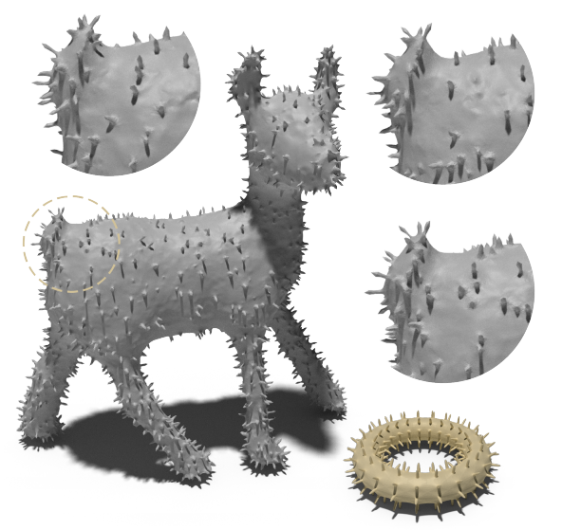
Geometric texture mapping
© Amir Hertz et al.

Slide 72
Geometric texture mapping
Amir Hertz et al., Deep geometric texture synthesis, ACM Transactions on Graphics, Volume 39, Issue 4, 202

Slide 73
Move it!!!

Slide 74
Animating motion
© Xue Bin Peng et al.

Slide 75
Animating motion
Daniele Reda et al., Learning to Locomote: Understanding How Environment Design Matters for Deep Reinforcement Learning, MIG 2020
Xue Bin Peng et al., Terrain-Adaptive Locomotion Skills Using Deep Reinforcement Learning, ACM Transactions on Graphics, Volume 35, Issue 4, 2016
Xue Bin Peng et al., Dynamic Terrain Traversal Skills Using Reinforcement Learning, ACM Transactions on Graphics, Volume 34, Issue 4, 2015
Xue Bin Peng et al., Learning Locomotion Skills Using DeepRL: Does the Choice of Action Space Matter?, ACM SIGGRAPH / Eurographics Symposium on Computer Animation 2017

Slide 76
That’s all folks
Looking forward to see your wonderful projects
Thank you!!!

